Slide 1
Asynchronous
Transfer Mode
(ATM)

Slide 2
Issues Driving LAN Changes
Traffic Integration
  Voice, video and data traffic
  Multimedia became the ‘buzz word’
    One-way batch Web traffic
    Two-way batch voice messages
    One-way interactive Mbone broadcasts
    Two-way interactive video conferencing
Quality of Service guarantees (e.g. limited jitter, non-blocking streams)
LAN Interoperability
Mobile and Wireless nodes

Slide 3
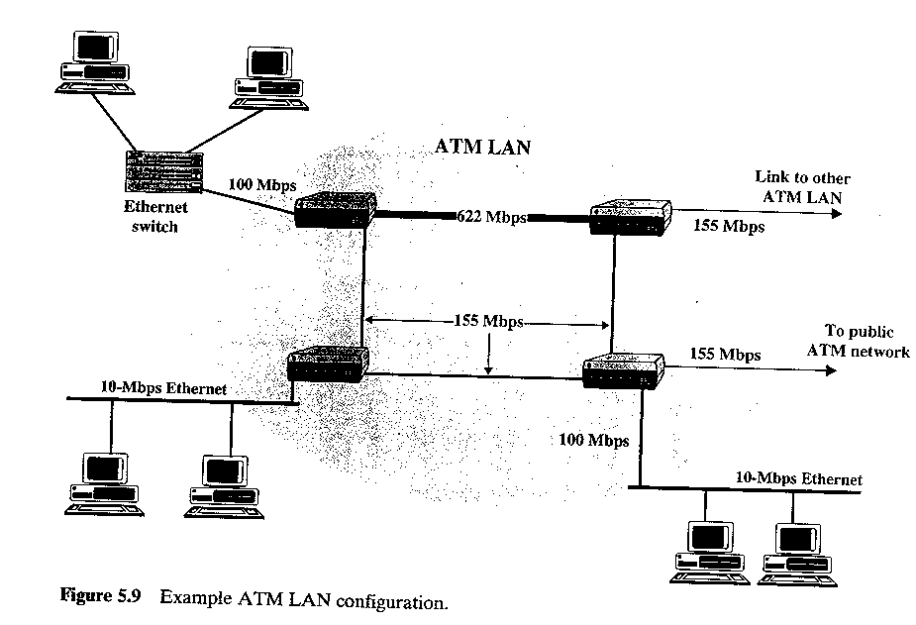
Stallings “High-Speed Networks”

Slide 4
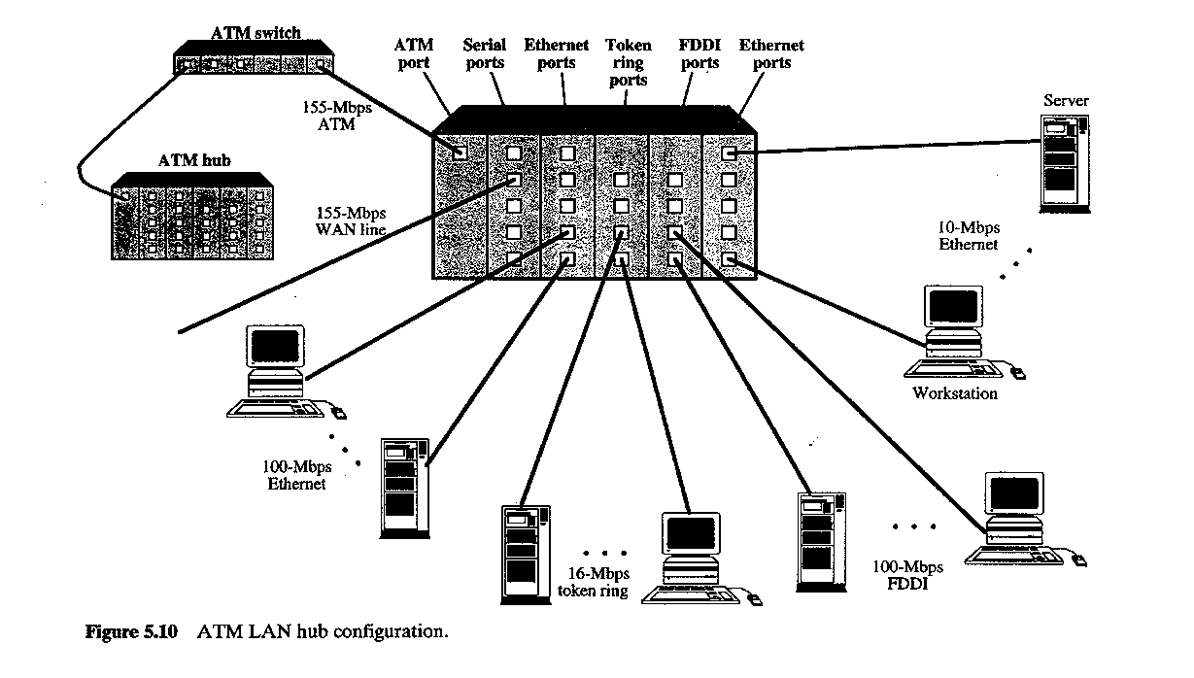
Stallings “High-Speed Networks”

Slide 5
Voice
ATM Adaptation Layers
A/D
AAL
s_{1 ,} s₂ …
cells
Digital voice samples
Video
A/D
…
Compression
AAL
cells
picture frames
compressed frames
Data
AAL
Bursty variable-length packets
cells
Copyright ©2000 The McGraw Hill Companies
Leon-Garcia & Widjaja: Communication Networks
Figure 9.3

Slide 6
Asynchronous Transfer Mode (ATM)
Voice
Data packets
MUX
Wasted bandwidth
Images
TDM
4 3 2 1 4 3 2 1 4 3 2 1
ATM
`
4 3 1 3 2 2 1
Copyright ©2000 The McGraw Hill Companies
Leon-Garcia & Widjaja: Communication Networks
Figure 7.37

Slide 7
ATM
ATM standard (defined by CCITT) is widely accepted by common carriers as mode of operation for communication – particularly BISDN.
ATM is a form of cell switching using small fixed-sized packets.
Basic ATM Cell Format
5 Bytes
48 Bytes
Header
Payload
Copyright ©2000 The McGraw Hill Companies
Leon-Garcia & Widjaja: Communication Networks
Figure 9.1

Slide 8
ATM Conceptual Model
Four Assumptions
ATM network will be organized as a hierarchy.
    User’s equipment connects to networks via a UNI (User-Network Interface).
    Connections between provided networks are made through NNI (Network-Network Interface).
ATM will be connection-oriented.
  A connection (an ATM channel) must be established before any cells are sent.

Slide 9
Private ATM network
Private UNI
X
X
Private NNI
X
Public UNI
Public ATM network A
X
X
NNI
Public UNI
X
B-ICI
Public ATM network B
X
Public UNI
X
X
Copyright ©2000 The McGraw Hill Companies
Leon-Garcia & Widjaja: Communication Networks
Figure 9.5

Slide 10
ATM Connections
two levels of ATM connections:
virtual path connections
virtual channel connections
indicated by two fields in the cell header:
virtual path identifier VPI
virtual channel identifier VCI

Slide 11
ATM Virtual Connections
Virtual Paths
Physical Link
Virtual Channels
Copyright ©2000 The McGraw Hill Companies
Leon-Garcia & Widjaja: Communication Networks
Figure 7.40

Slide 12
ATM Conceptual Model
Assumptions (cont.)
Vast majority of ATM networks will run on optical fiber networks with extremely low error rates.
ATM must support low cost attachments.
  This decision lead to a significant decision – to prohibit cell reordering in ATM networks.
  ➔ ATM switch design is more difficult.

Slide 13
UNI Cell Format
GFC (4 bits)
VPI (4 bits)
VPI (4 bits)
VCI (4 bits)
ATM cell header
VCI (8 bits)
VCI (4 bits)
PT (3 bits)
CLP (1 bit)
HEC (8 bits)
Payload (48 bytes)
Copyright ©2000 The McGraw Hill Companies
Leon-Garcia & Widjaja: Communication Networks
Figure 9.7

Slide 14
ATM Cell Switching
1
Switch
voice
67
1
…
video
67
2
5
video
25
voice
32
25
N
75
32
1
67
data
39
3
32
3
39
6
data
32
video
61
61
2
67
…
…
N
video
75
N
Copyright ©2000 The McGraw Hill Companies
Leon-Garcia & Widjaja: Communication Networks
Figure 7.38

Slide 15
VP3
a
VP5
a
b
ATM
Sw
1
ATM
DCC
ATM
Sw
2
b
c
ATM
Sw
3
c
d
e
VP2
VP1
ATM
Sw
4
d
Sw = switch
e
Digital Cross Connect
Only switches virtual paths
Copyright ©2000 The McGraw Hill Companies
Leon-Garcia & Widjaja: Communication Networks
Figure 7.39

Slide 16
ATM Protocol Architecture
ATM Adaptation Layer (AAL) – the protocol for packaging data into cells is collectively referred to as AAL.
Must efficiently package higher level data such as voice samples, video frames and datagram packets into a series of cells.
Design Issue: How many adaptation layers should there be?

Slide 17
Management plane
Plane management
Control plane
User plane
Layer management
Higher layers
Higher layers
ATM adaptation layer
ATM layer
Physical layer
Copyright ©2000 The McGraw Hill Companies
Leon-Garcia & Widjaja: Communication Networks
Figure 9.2

Slide 18
User information
User information
AAL
AAL
ATM
ATM
ATM
ATM
PHY
PHY
PHY
PHY
…
End system
Network
End system
Copyright ©2000 The McGraw Hill Companies
Leon-Garcia & Widjaja: Communication Networks
Figure 9.4

Slide 19
Original ATM Architecture
CCITT envisioned four classes of applications (A-D) requiring four distinct adaptation layers (1-4) which would be optimized for an application class:
  Constant bit-rate applications CBR
  Variable bit-rate applications VBR
  Connection-oriented data applications
  Connectionless data application

Slide 20
ATM Architecture
An AAL is further divided into:
  The Convergence Sublayer (CS)
  manages the flow of data to and from SAR sublayer.
  The Segmentation and Reassembly Sublayer
  (SAR)
  breaks data into cells at the sender and reassembles
  cells into larger data units at the receiver.

Slide 21
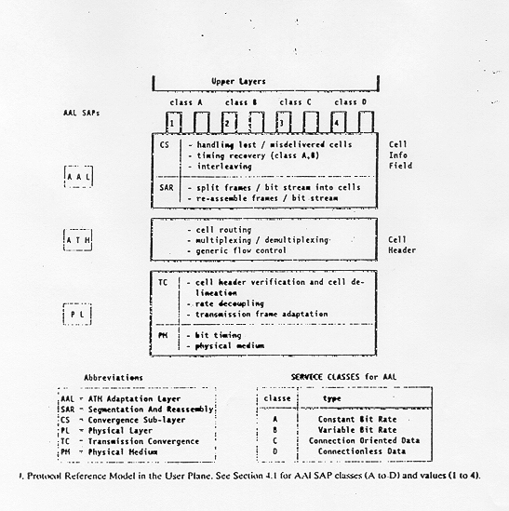
Original ATM Architecture

Slide 22
ATM layer
Transmission convergence sublayer
Physical layer
Physical medium dependent sublayer
Physical medium
Copyright ©2000 The McGraw Hill Companies
Leon-Garcia & Widjaja: Communication Networks
Figure 9.6

Slide 23
Original ATM Architecture
The AAL interface was initially defined as classes A-D with SAP (service access points) for AAL1-4.
AAL3 and AAL4 were so similar that they were merged into AAL3/4.
The data communications community concluded that AAL3/4 was not suitable for data communications applications. They pushed for standardization of AAL5 (also referred to as SEAL – the Simple and Efficient Adaptation Layer).
AAL2 was not initially deployed.

Slide 24
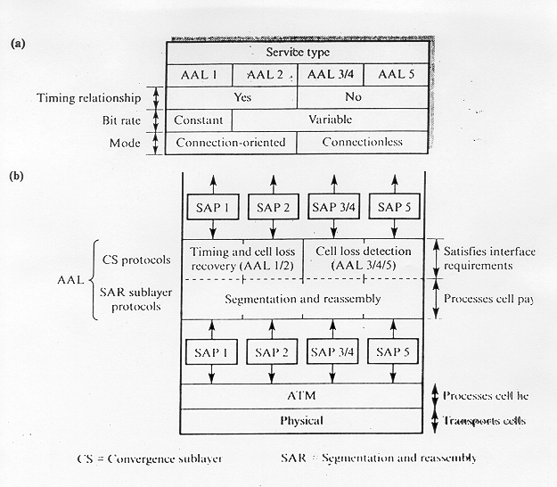
Revised ATM Architecture

Slide 25
Revised ATM Service Categories
Class | Description | Example
CBR | Constant Bit Rate | T1 circuit
RT-VBR | Real Time Variable Bit Rate | Real-time videoconferencing
NRT-VBR | Non-real-time Variable Bit Rate | Multimedia email
ABR | Available Bit Rate | Browsing the Web
UBR | Unspecified Bit Rate | Background file transfer

Slide 26
QoS, PVC, and SVC
Quality of Service (QoS) requirements are handled at connection time and viewed as part of signaling.
ATM provides permanent virtual connections and switched virtual connections.
  Permanent Virtual Connections (PVC)
permanent connections set up manually by network manager.
  Switched Virtual Connections (SVC)
  set up and released on demand by the end user via signaling procedures.

Slide 27
AAL 1 Payload
(b) CS PDU with pointer in structured data transfer
47 Bytes
AAL 1 Pointer
1 Byte
46 Bytes
optional
(a) SAR PDU header
CSI
Seq. Count
SNP
1 bit 3 bits 4 bits
Copyright ©2000 The McGraw Hill Companies
Leon-Garcia & Widjaja: Communication Networks
Figure 9.11

Slide 28
AAL 1
Higher layer
User data stream
b₁ b₂ b₃
…
Convergence sublayer
CS PDUs
47
47
47
SAR PDUs
SAR sublayer
H
H
H
1 47
1 47
1 47
ATM layer
H
H
ATM Cells
H
5 48
5 48
5 48
Copyright ©2000 The McGraw Hill Companies
Leon-Garcia & Widjaja: Communication Networks
Figure 9.10

Slide 29
AAL 3/4
CS and SAR PDUs
(a) CPCS-PDU format
Header
Trailer
CPI Btag BASize
CPCS - PDU Payload
Pad
AL Etag Length
1 1 2 1 - 65,535 0-3 1 1 2 (bytes) (bytes) (bytes)
(b) SAR PDU format
Header (2 bytes)
Trailer (2 bytes)
ST SN MID
SAR - PDU Payload
LI CRC
2 4 10 44 6 10 (bits) (bytes) (bits)
Copyright ©2000 The McGraw Hill Companies
Leon-Garcia & Widjaja: Communication Networks
Figure 9.16

Slide 30
AAL 3/4
Higher layer
Information
User message
Service specific convergence sublayer
Assume null
Common part convergence sublayer
Pad message to multiple of 4 bytes. Add header and trailer.
H
Information
PAD
T
4
4
SAR sublayer
…
Each SAR-PDU consists of 2-byte header, 2-byte trailer, and 44-byte payload.
2 44 2
2 44 2
2 44 2
ATM layer
…
Copyright ©2000 The McGraw Hill Companies
Figure 9.15
Leon-Garcia & Widjaja: Communication Networks

Slide 31
AAL 5
Convergent Sublayer Format
Information
Pad
UU CPI Length CRC
0 - 65,535 0-47 1 1 2 4 (bytes) (bytes)
SAR Format
ATM
Header
48 bytes of Data
1-bit end-of-datagram field (PTI)
Copyright ©2000 The McGraw Hill Companies
Leon-Garcia & Widjaja: Communication Networks
Figure 9.19

Slide 32
AAL 5
Higher layer
Information
Service specific convergence sublayer
Assume null
Common part convergence sublayer
Information
PAD
T
SAR sublayer
…
48 (0)
48 (0)
48 (1)
Figure 9.18
ATM layer
…
Copyright ©2000 The McGraw Hill Companies
PTI = 1
PTI = 0
PTI = 0
Leon-Garcia & Widjaja: Communication Networks

